Slide 1
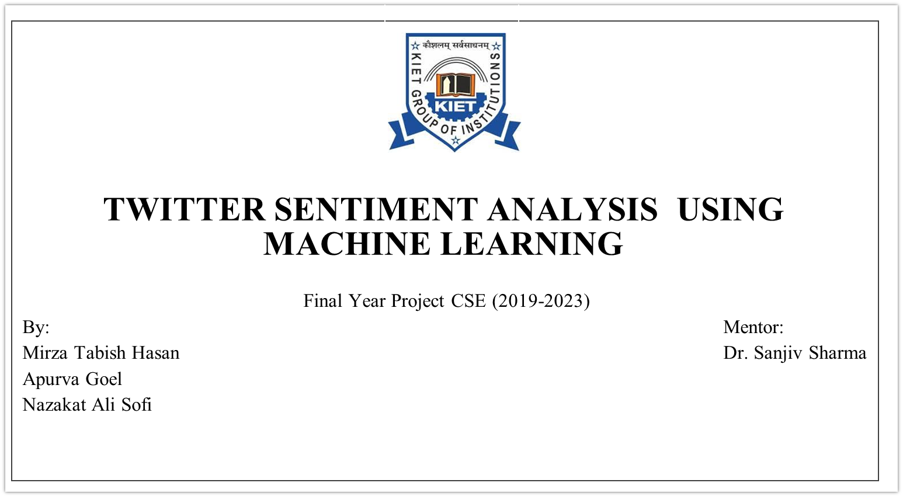

Slide 2
Machine Learning Approach for Sentiment Analysis on Twitter
This presentation provides an overview of a machine learning approach for sentiment analysis on Twitter. It covers the relevance of sentiment analysis in social media, the project objectives, methodology, algorithms used, dataset description, feature extraction, evaluation, and experimental results.

Slide 3
Introduction
In the era of social media dominance, platforms like Twitter have become powerful sources of real-time information and opinions. With millions of users expressing their thoughts, reviews, and sentiments in short, concise messages called tweets, Twitter has emerged as a goldmine for understanding public sentiment. However, manually analyzing such massive volumes of data is a daunting task. This is where machine learning comes into play.
Machine learning, a subfield of artificial intelligence, offers automated techniques to analyze and interpret textual data at scale. Sentiment analysis, also known as opinion mining, is a prominent application of machine learning in which the sentiment or emotional tone of a given text is determined. By employing machine learning algorithms, sentiment analysis on Twitter can provide valuable insights into people's attitudes, emotions, and opinions towards various topics, brands, or events.
In this presentation, we will explore a machine learning approach to sentiment analysis on Twitter. We will delve into the process of collecting and preprocessing Twitter data, extracting relevant features from tweets, and training machine learning models to classify sentiments. Through this approach, we aim to uncover patterns, trends, and sentiments prevalent within the Twitterverse, enabling businesses, governments, and individuals to make data-driven decisions and gain a deeper understanding of public perception.

Slide 4
Methodology
Acquired the data from online repository Kaggle
Cleaning of the data by using text processing in nlp
Training of six supervised machine learning algorithms
Testing to find the performance of each algorithm
Conclusion of the research by comparing all the results.

Slide 5
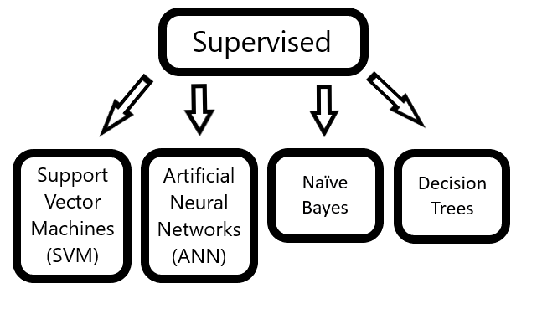
Machine Learning Algorithms
Selection and implementation of six machine learning algorithms:
Decision Tree
Random Forest
Logistic Regression
Support Vector Machine
Gradient Boosting Machine
K-Nearest Neighbors.

Slide 6
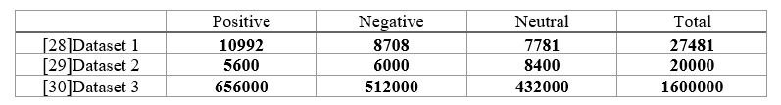
Dataset Description
The Dataset used in the project is fetched from online repository kaggle :-

Slide 7
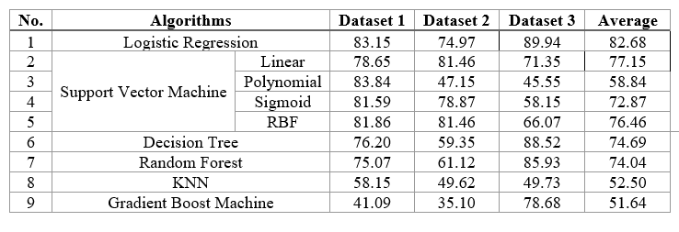
Algorithm Training and Evaluation

Slide 8
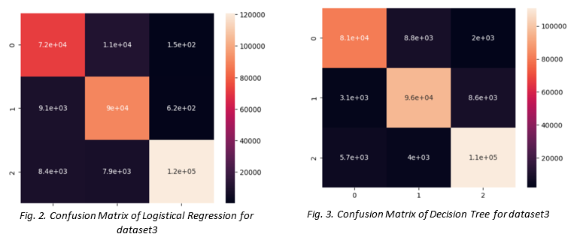
Experimental Results

Slide 9
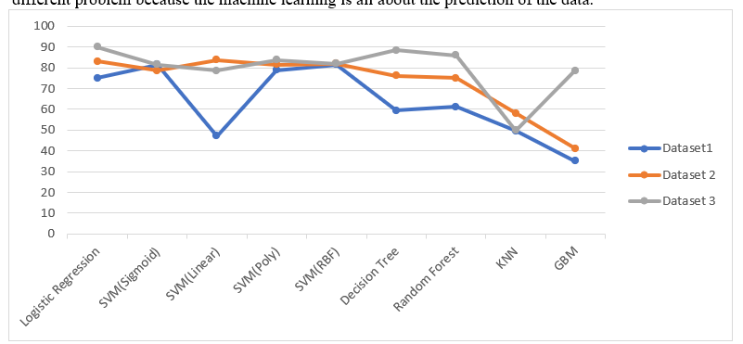
Algorithm Performance Comparison

Slide 10
Conclusion
In this project the overall analysis of different models based on machine learning are used to analyse the sentiments. The analyses done on the data set which we have trained in this project provide us the following result:
The best model for sentiment analyses is Logistic Regression for our dataset which provides an accuracy of 89.94%. The second model is Decision Tree Algorithms which provides an accuracy of 88.52%. But this accuracy can change depending on the different dataset. The result of accuracy will vary according to the type of dataset. Figure 1 shows a plot of the accuracy of different algorithms on a linear graph. It shows the performance of different models on the tweets.

